Slide 1

Business Sales & Financial Performance Dashboard
By: Manvi Rana
Tool Used: Power BI
This Photo by Unknown Author is licensed under CC BY-SA

Slide 2

Objective
To design an interactive dashboard that helps business stakeholders track Revenue, Growth, and Sales Performance for better decision-making.

Slide 3

Approach / Steps Taken
Chose Key KPIs (Total Revenue, Average Revenue, Total Transactions, Total Countries).
Added slicers & filters (Year, Quarter, Store) for interactivity.
Created time-series analysis (Revenue by Quarter & Month).
Used cards & visuals for summary.
Applied consistent theme for business reporting.

Slide 4
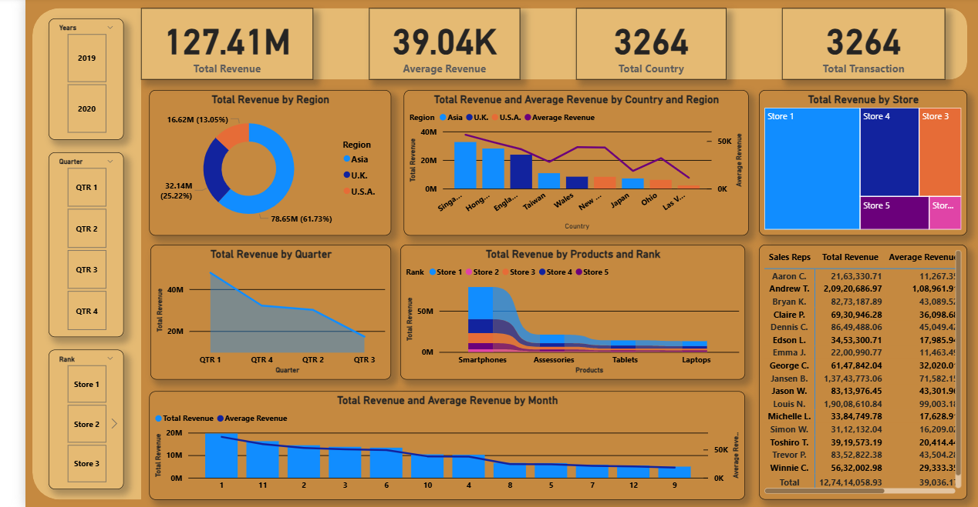
Dashboard Screenshot

Slide 5

Key Insights
USA contributed 61% of total revenue.
Q1 had the highest revenue (42M), while Q3 was lowest.
Store 1 is the top revenue contributor among all stores.
Smartphones generate the highest product revenue.

Slide 6

Conclusion
A comprehensive view of sales & revenue trends.
Easy-to-use filters for exploring data.
Actionable insights that support business decision-making.

